Slide 1
DEPI Final Project
Fortinet Cybersecurity Engineer

Slide 2
Agenda
1 – what is VPN
2- site to site VPN
3 – ipsec VPN
4 – implementation and simple topology

Slide 3

What is VPN ?
A VPN (Virtual Private Network):
is a technology that creates a secure and encrypted connection over a less secure network, such as the internet. VPNs are used to enhance privacy, protect sensitive data, and enable secure communication. They work by encrypting your data and routing it through a remote server, hiding your IP address and online activities.

Slide 4

Type of VPN:
1. Remote Access VPN
Purpose: Enables users to securely connect to a private network (e.g., an office network) from a remote location.
2. Site-to-Site VPN
Purpose: Connects entire networks (e.g., two office branches) over the internet securely.
3. Client-to-Site VPN
Purpose: Similar to remote access but more tailored to individual users needing direct access to a corporate network.

Slide 5

Type of VPN:
4. SSL VPN (Secure Sockets Layer VPN)
Purpose: Provides secure remote access without requiring specialized software.
5. MPLS VPN (Multiprotocol Label Switching VPN)
Purpose: Uses MPLS technology to connect different locations over a service provider's private network.
6. Mobile VPN
Purpose: Designed for users on mobile devices who frequently switch between networks or maintain active sessions.

Slide 6

Type of VPN:
7. Cloud VPN
Purpose: Extends secure connections to cloud environments.
8. Peer-to-Peer (P2P) VPN
Purpose: Used for secure file sharing or decentralized network setups.

Slide 7

VPN Protocols
VPNs can also be categorized based on the protocols they use:
OpenVPN: Open-source, highly secure, and flexible.
IKEv2/IPsec: Secure and stable, especially for mobile devices.
L2TP/IPsec: A combination of Layer 2 Tunneling Protocol and IPsec encryption.
PPTP: Fast but outdated and less secure.
WireGuard: Modern, lightweight, and efficient.

Slide 8
Site To Site VPN:
Purpose: Connects entire networks (e.g., two office branches) over the internet securely.
Use Case: Large organizations that need to interconnect geographically separated networks.
How It Works:
Establishes a secure tunnel between routers or gateways of two networks.
Subtypes:
Intranet-based Site-to-Site VPN: Connects different branches of the same organization.
Extranet-based Site-to-Site VPN: Connects an organization’s network with that of a partner organization.

Slide 9

IPsec VPN Site TO Site:
What is IPsec? When should you use it?
IPsec is a vendor-neutral set of standard protocols that is used to join two physically distinct LANs. The LANs are joined as if they were a single logical network, despite being separated by the internet.

Slide 10
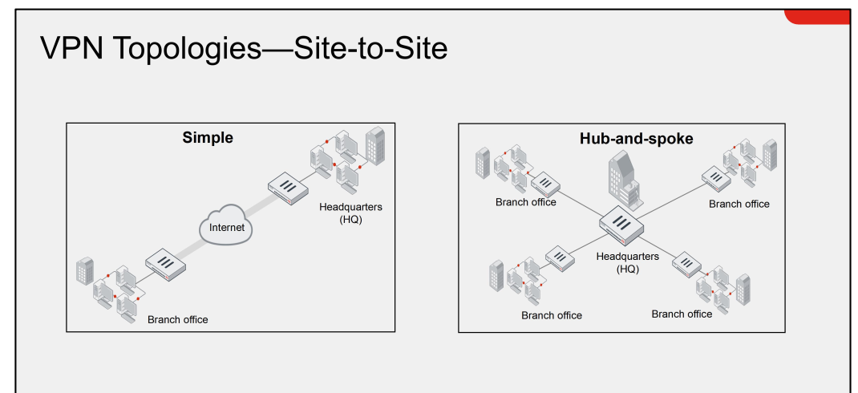
Site To Site Topologys:

Slide 11
Simple Topology and implementation on EVE Environment

Slide 12
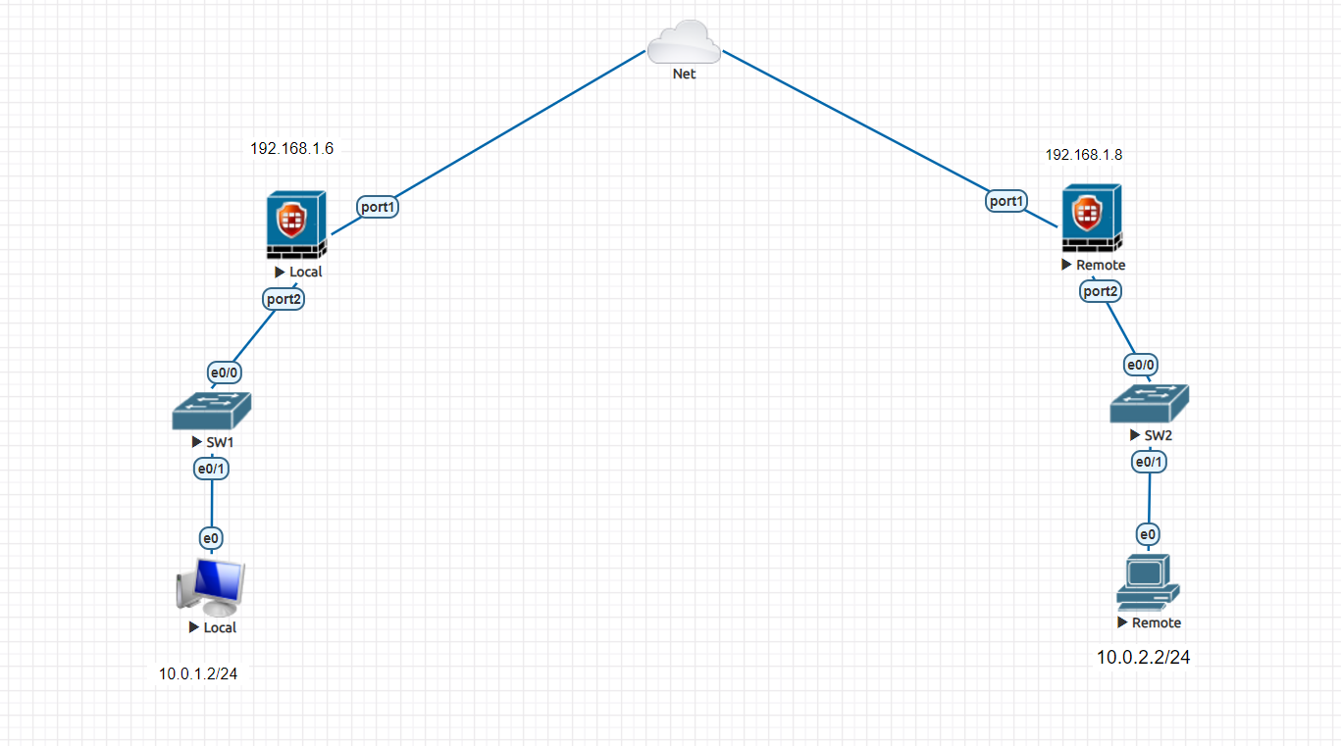
Toplogy Will Work on

Slide 13
Methods to make ipsec Tunnle
1 – Manually
2 – using Wizerd
So For simplicity we will use ipsec wizerd

Slide 14
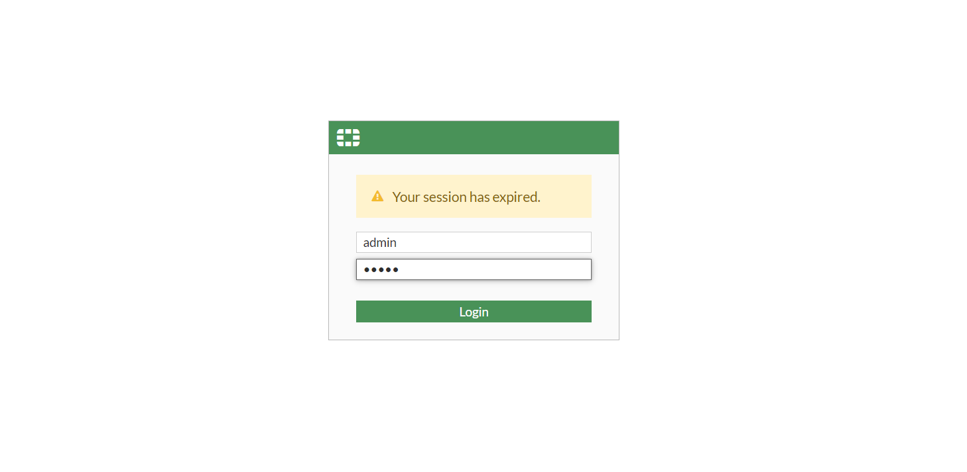
Ipsec using ipsec wizard in Fortigate:
Local Fortigate:
Login:

Slide 15
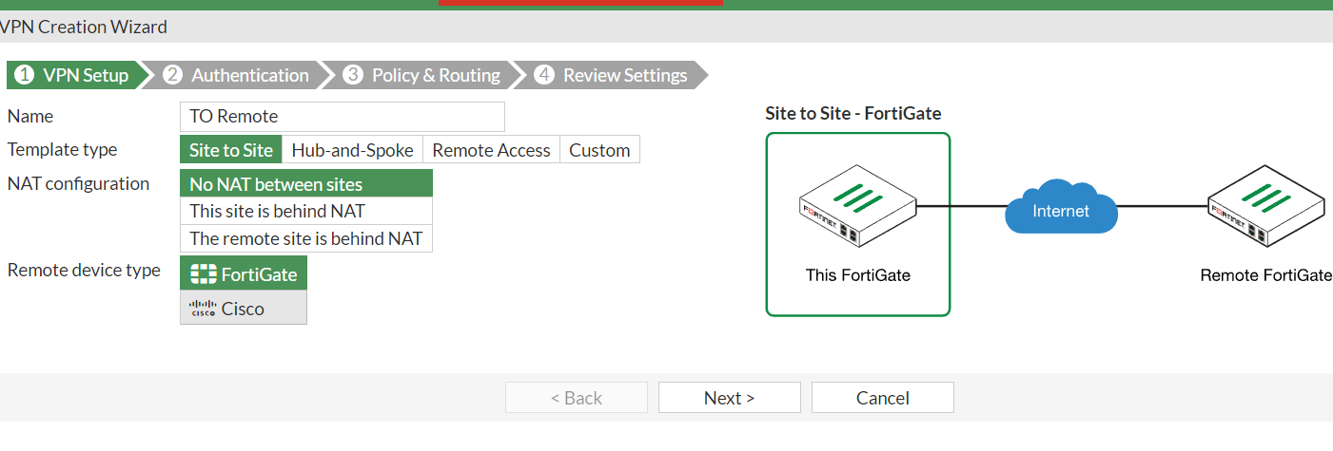
Go to vpn tab:
1 – select ipsec wizard
Then fill the information about the Remote site

Slide 16
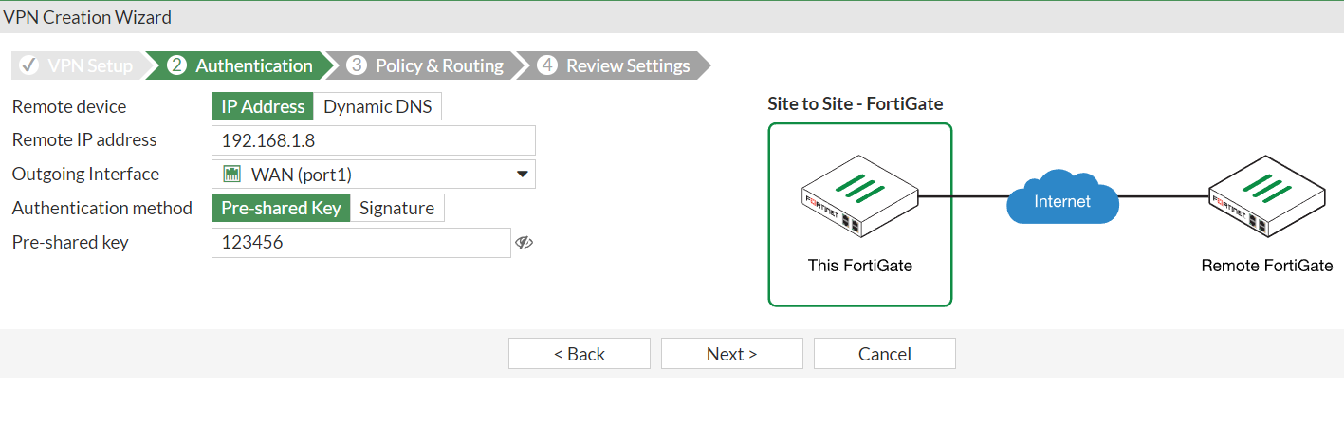
Make the Authentication configuration

Slide 17
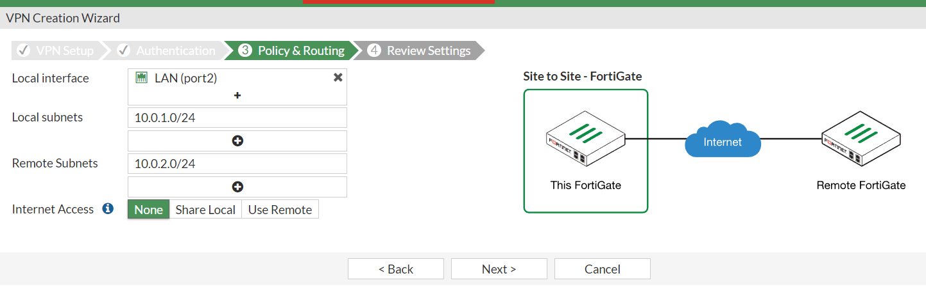
Make routing policy for forward the traffic

Slide 18
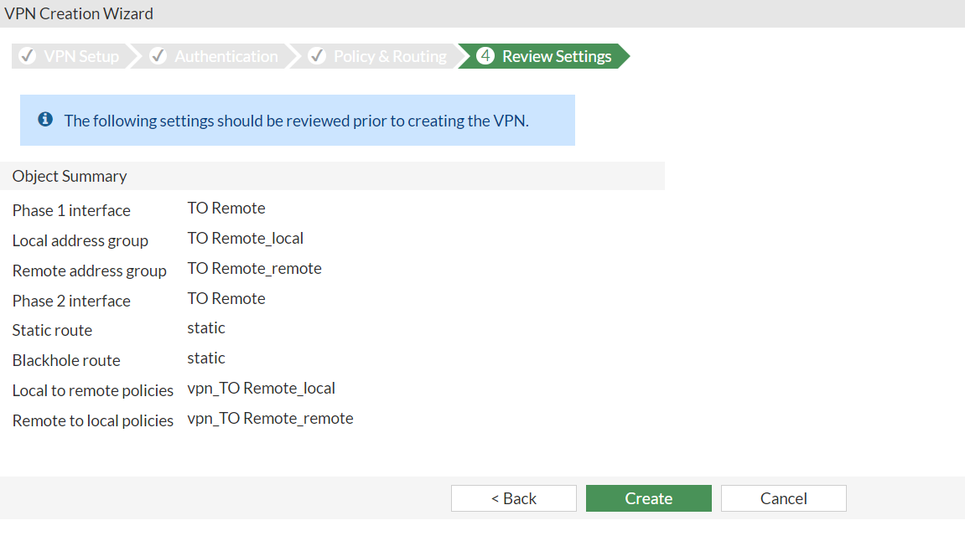
Finally review your configuration:

Slide 19
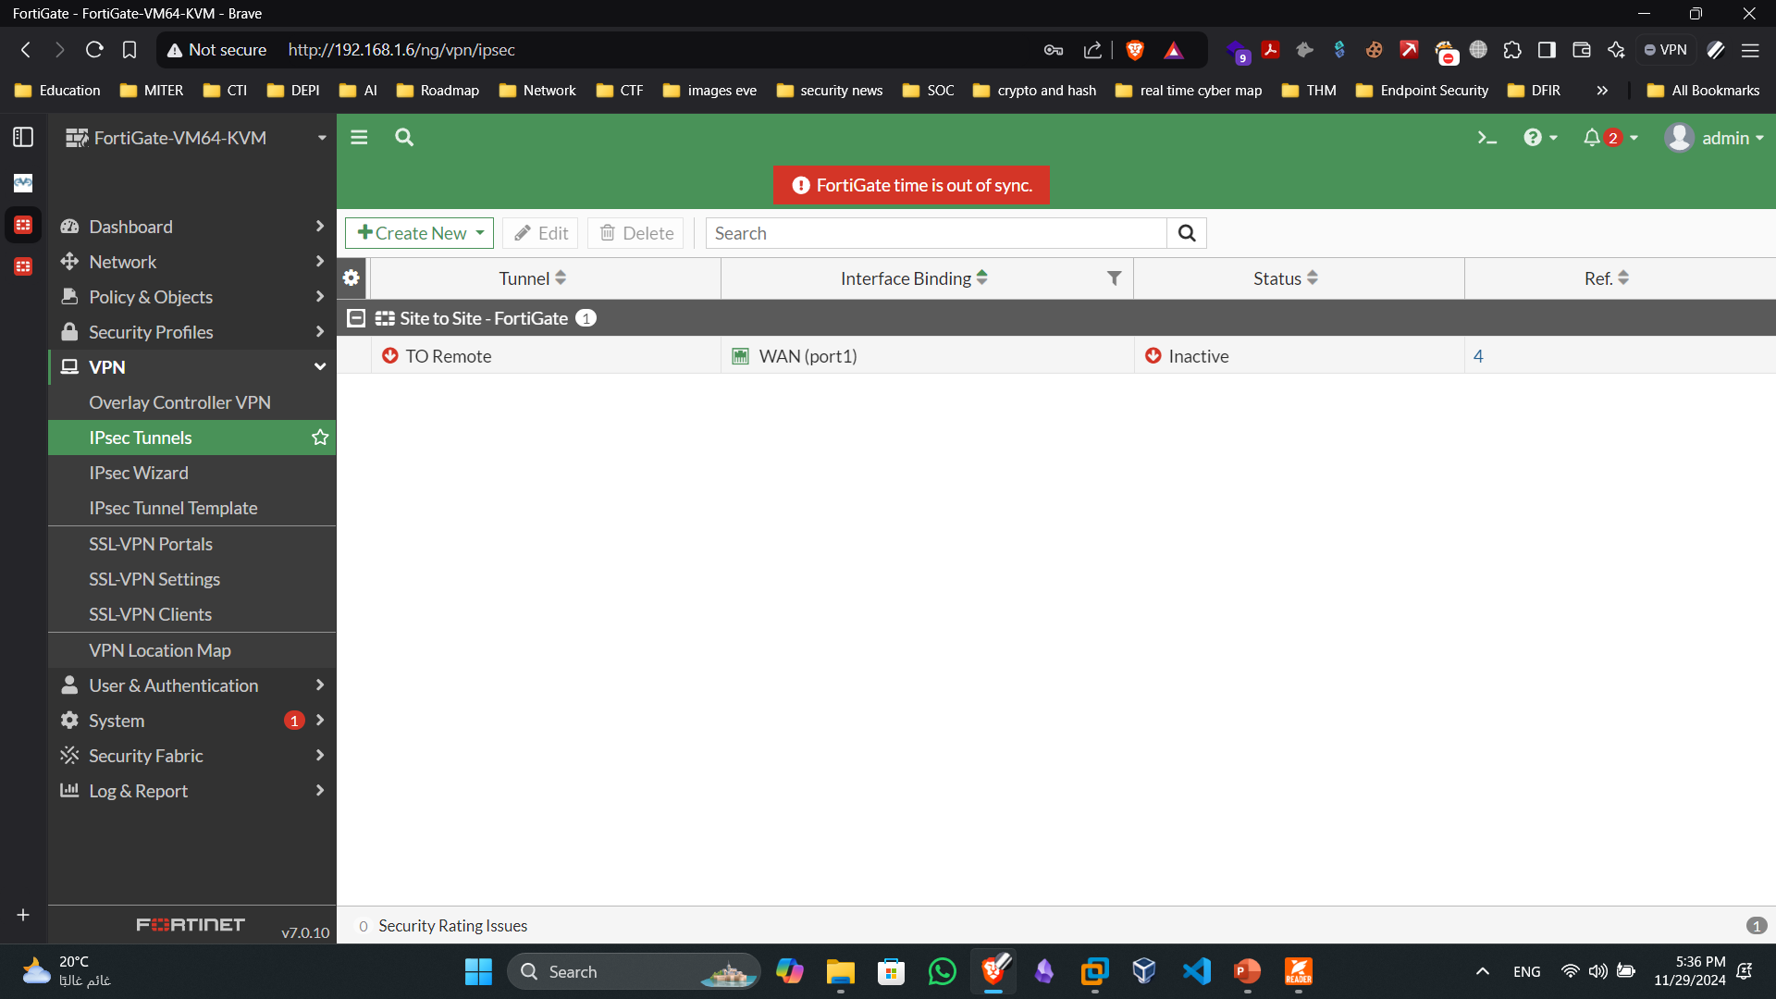
The First VPN site ready:

Slide 20
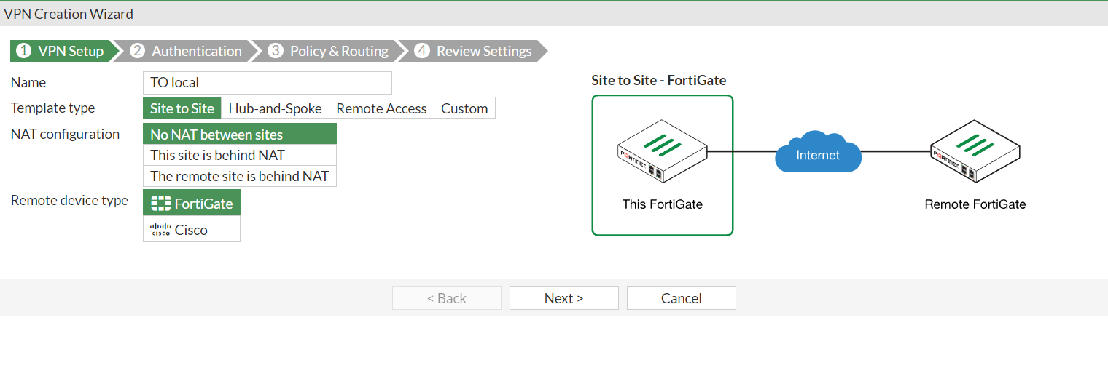
Go to the remote side the make the same conf

Slide 21
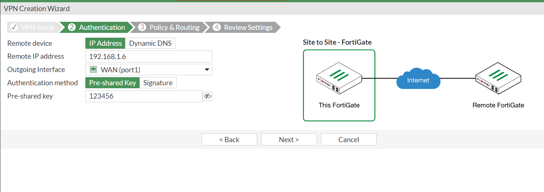
Choose your Remote IP and the interface

Slide 22
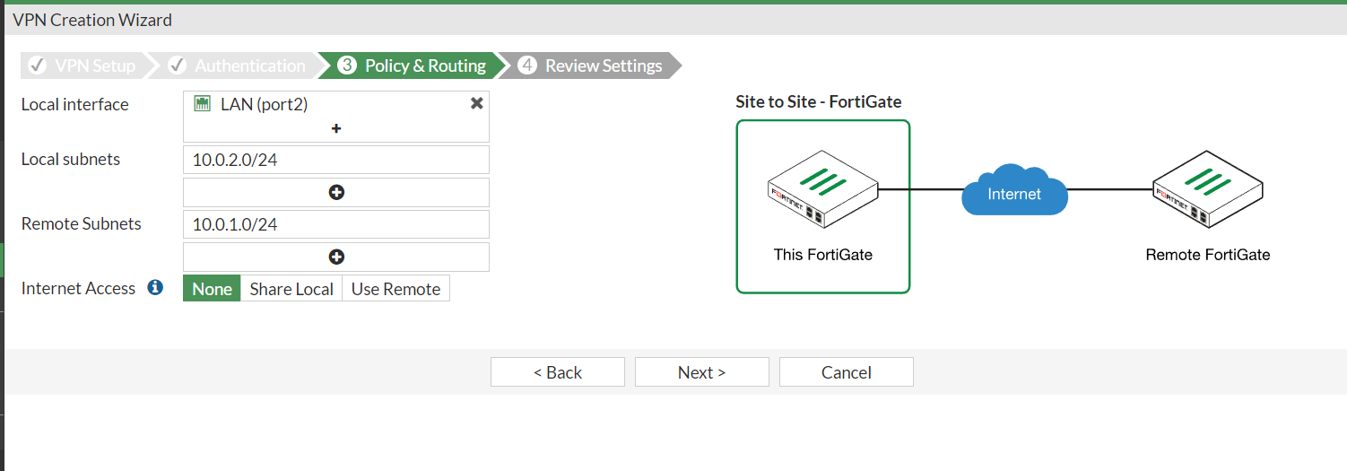
Choose what is the local and remote subnets:

Slide 23
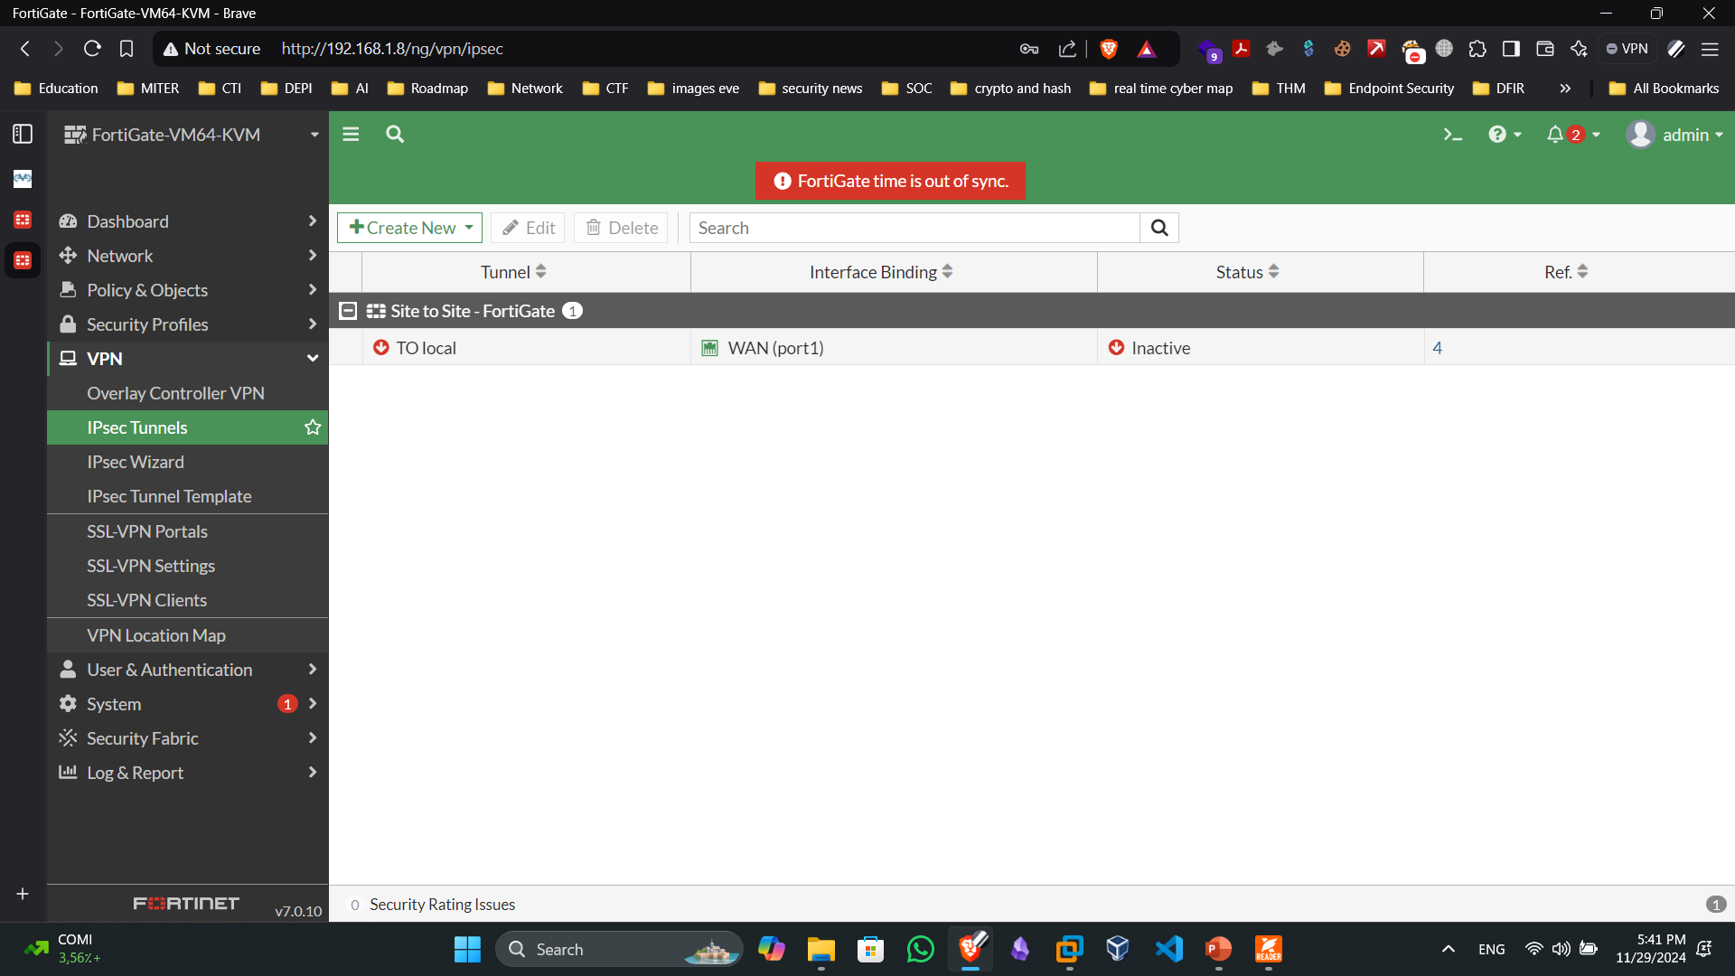
The Second site now ready:

Slide 24
Back to the first site and show:
Because We use the wizard we just choose the configuration and don’t make any custome configuration
So let set the configuration that done automatically with using the wizard

Slide 25
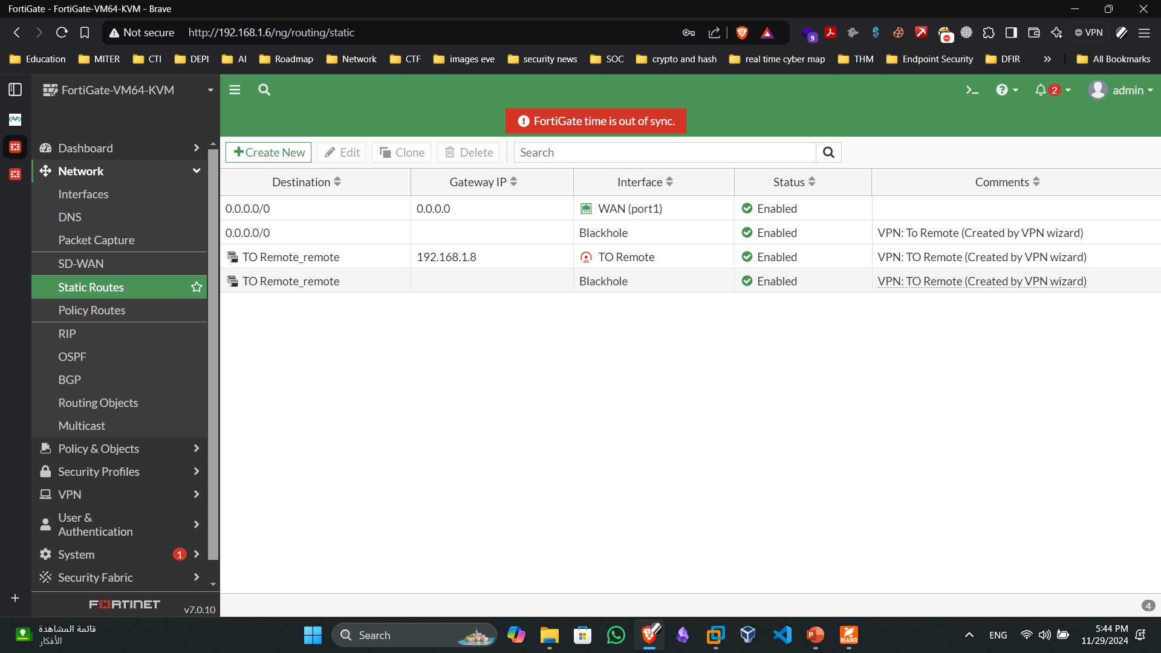
From the first side:
Static routes addes automatic:

Slide 26
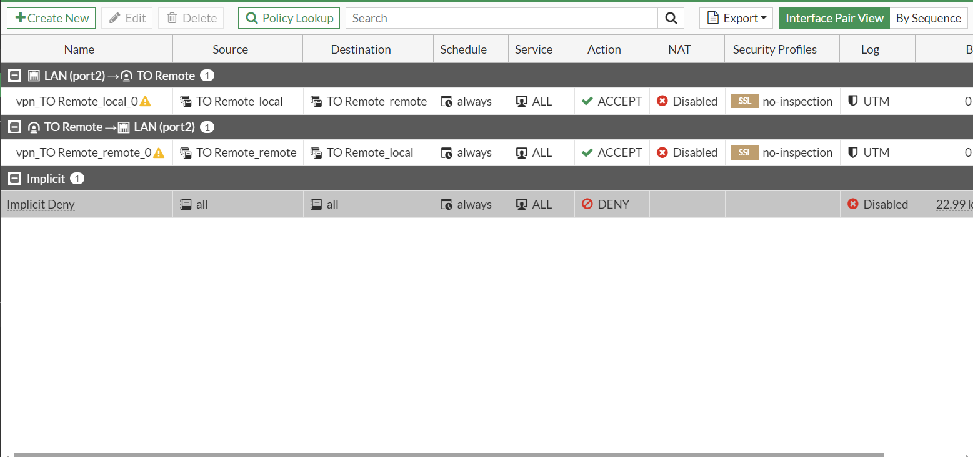
The policy created automatic:

Slide 27
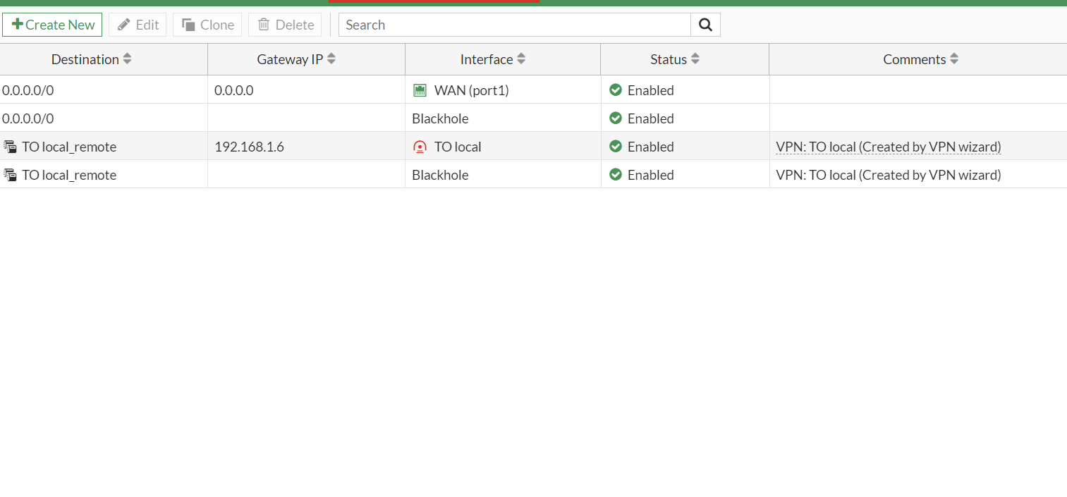
The secode or the remote site:
Static routes :

Slide 28
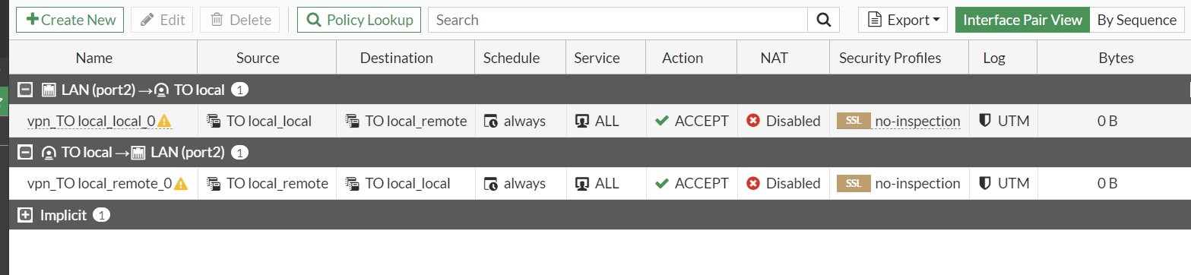
The policy created automatic:

Slide 29
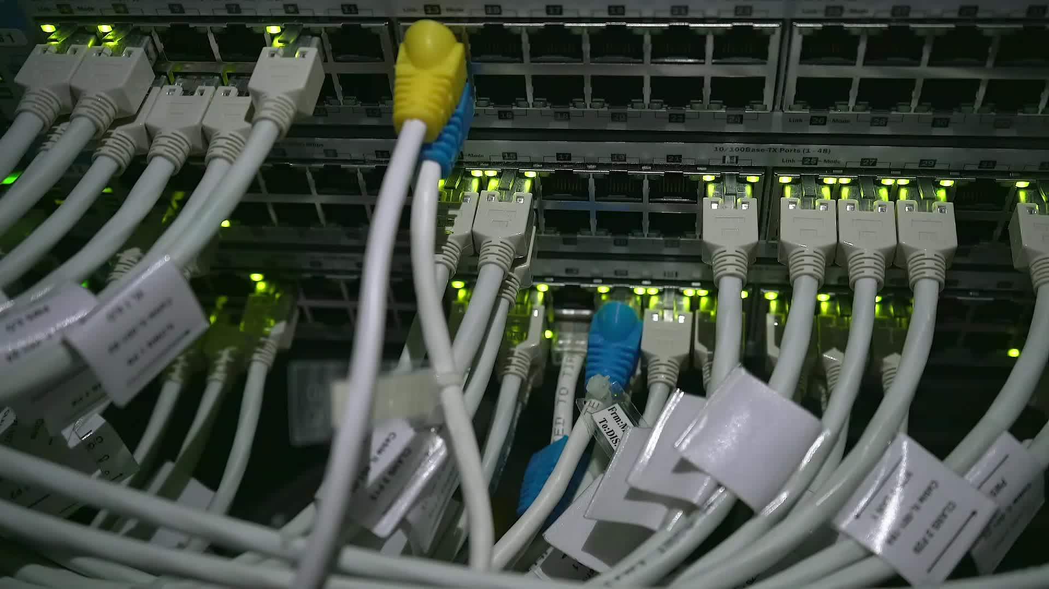
Now Lets Test Connectivity

Slide 30
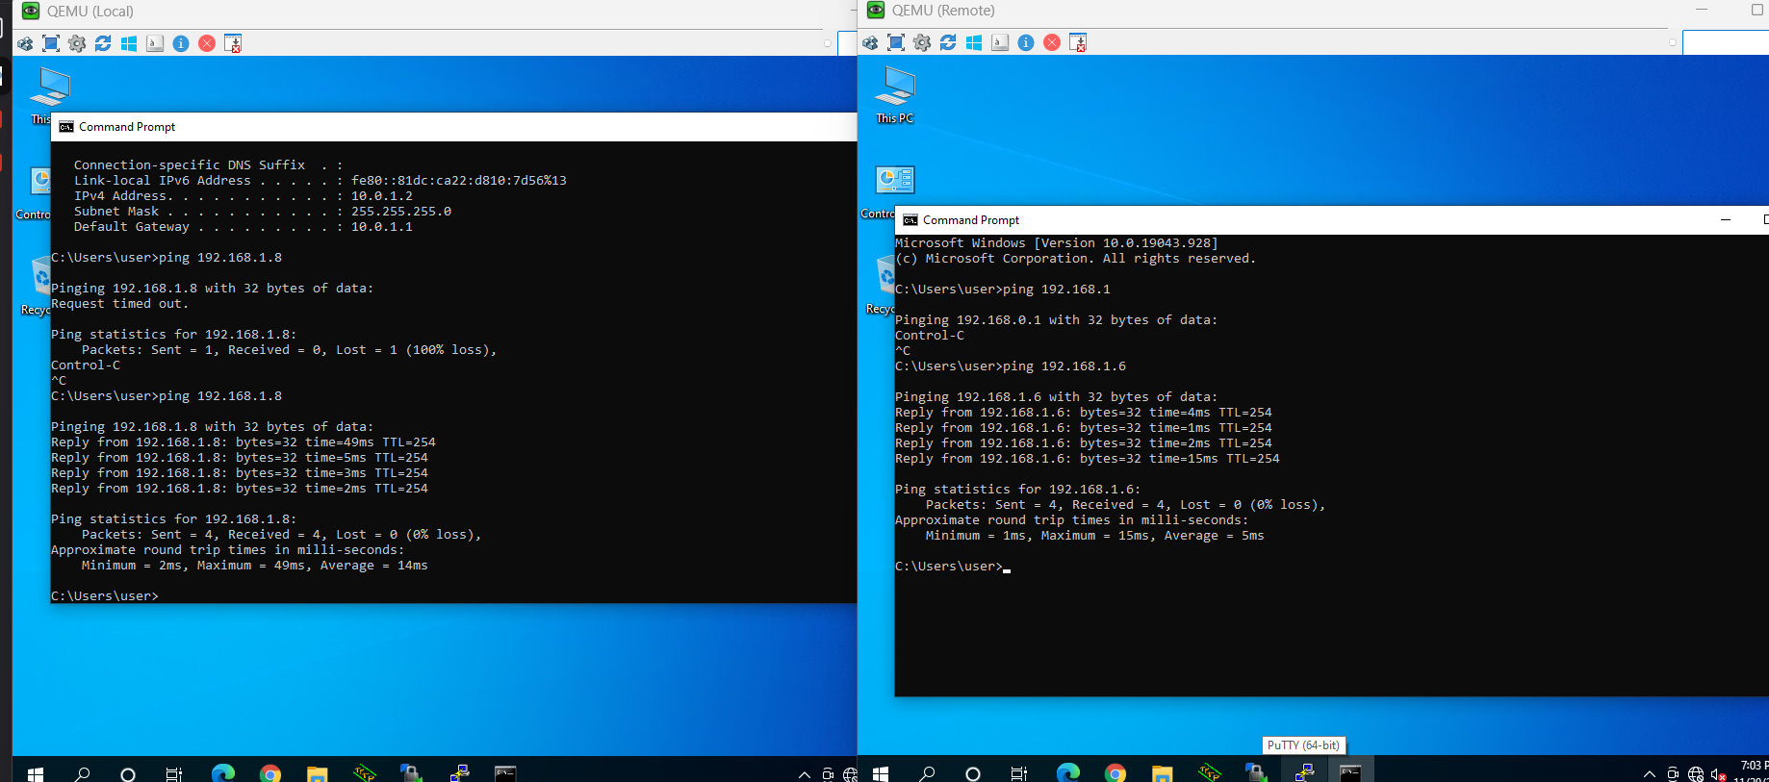
Test Gatways:

Slide 31
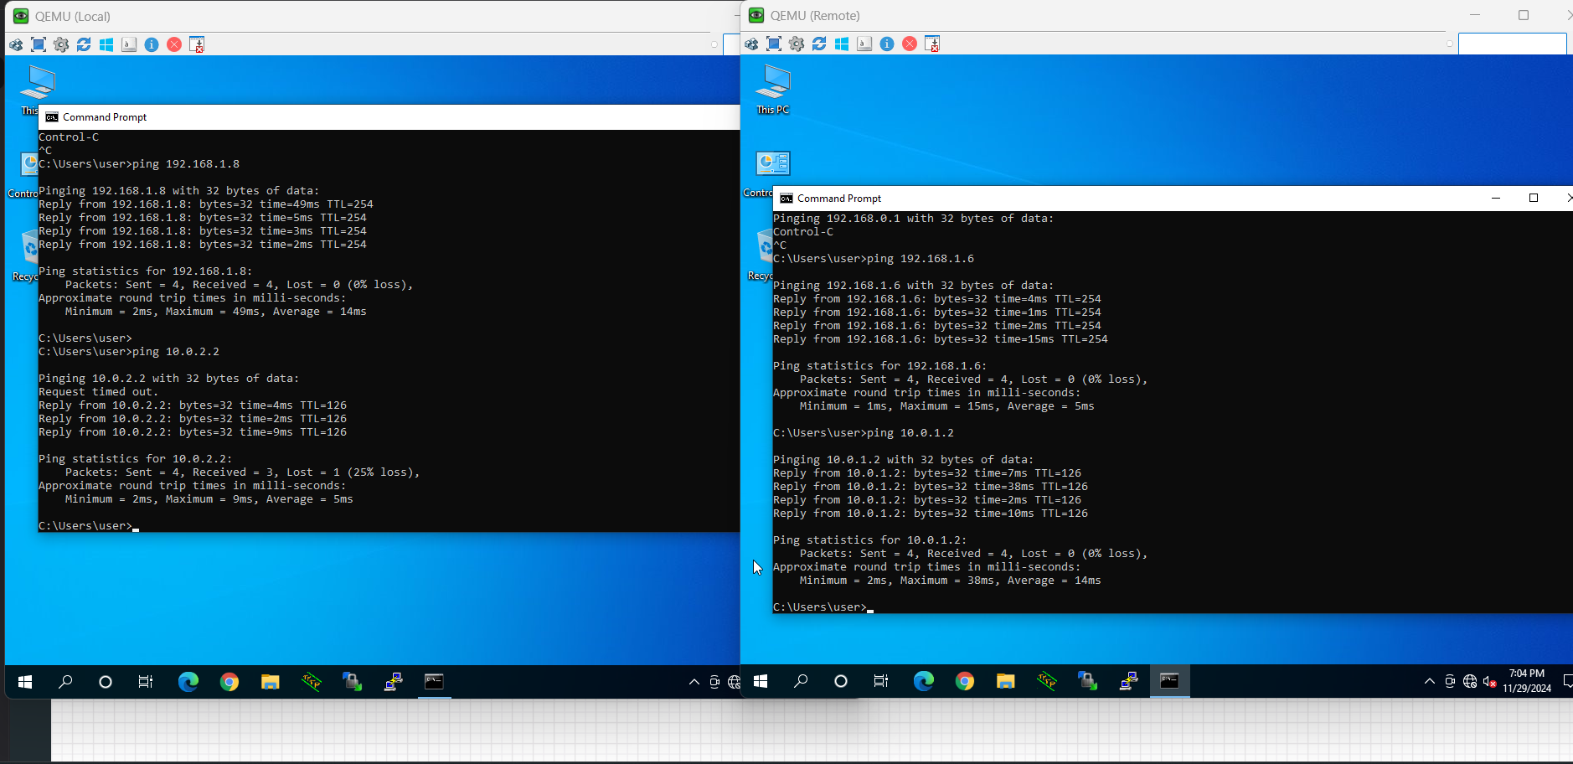
Test connectivity between hosts

Slide 32

Finally make successful ipsec tunnels between two sites to secure the communication between them

Slide 33

Q&A LinkedIn:www.linkedin.com/in/momen-ameer-7b3032233 mail: momenameer2003@gmail.com

Slide 34

Thank you

